Slide 1
Demographic and race prediction of twitter users
Team members: Finn Jensen, Nick Zotalis, Keith Tyser, Aditya Agrawal, Minh Nguyen

Slide 2
Preprocessing Data for Race Prediction

Slide 3
Userdemo.json

Slide 4
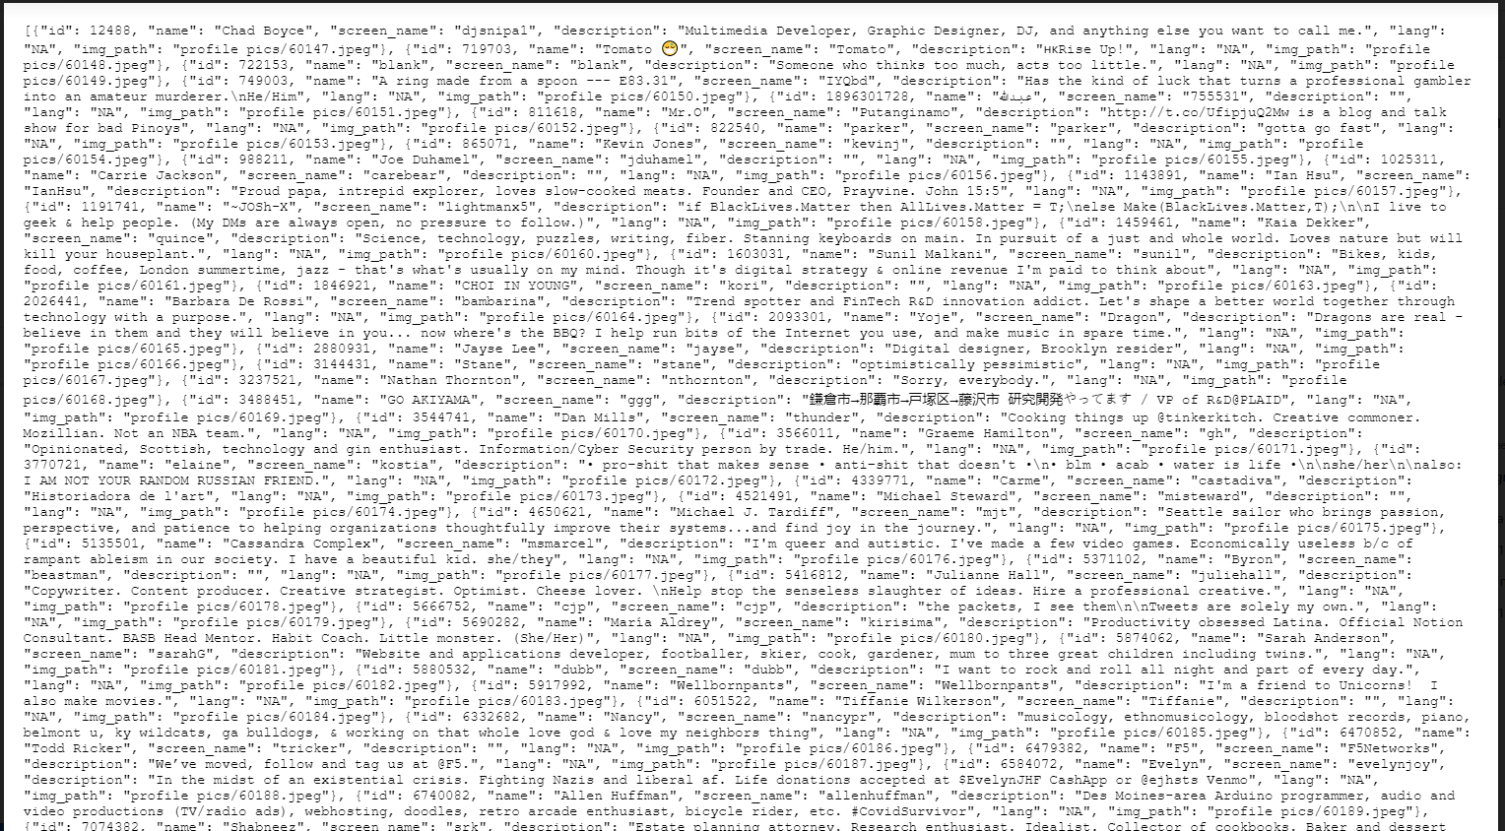

Slide 5
Twitter_users_Labeled.json

Slide 6
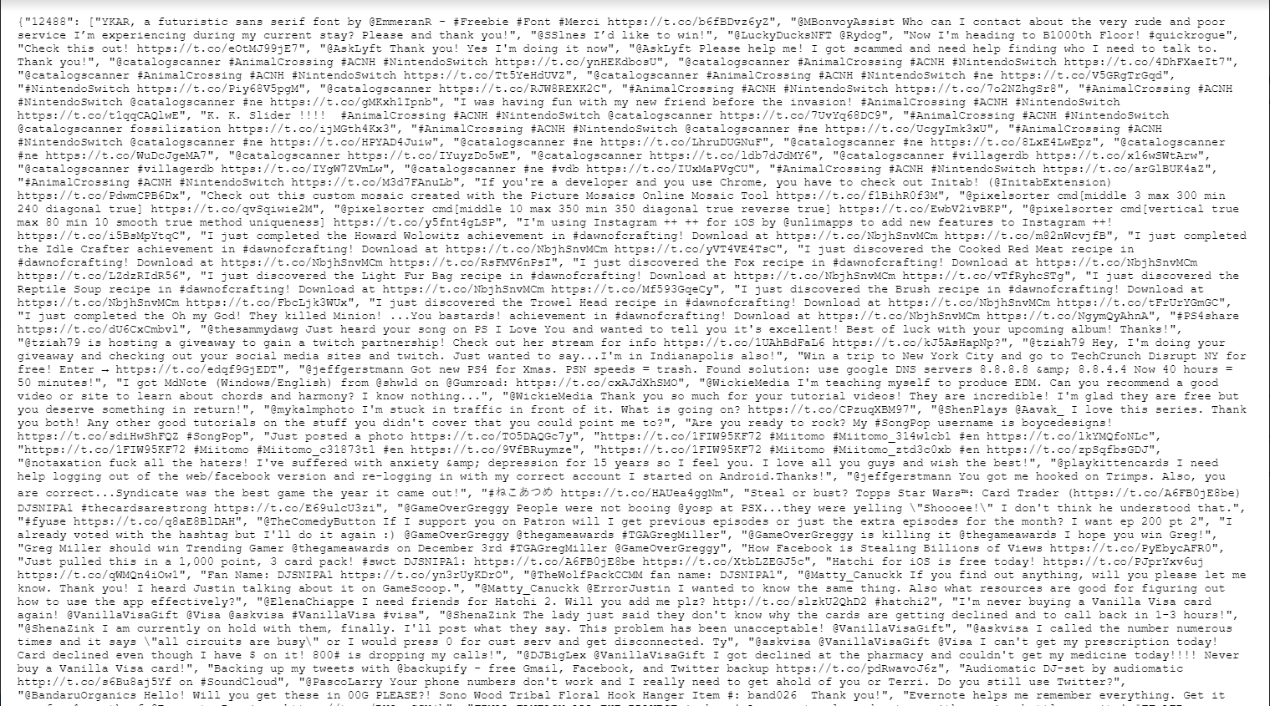

Slide 7
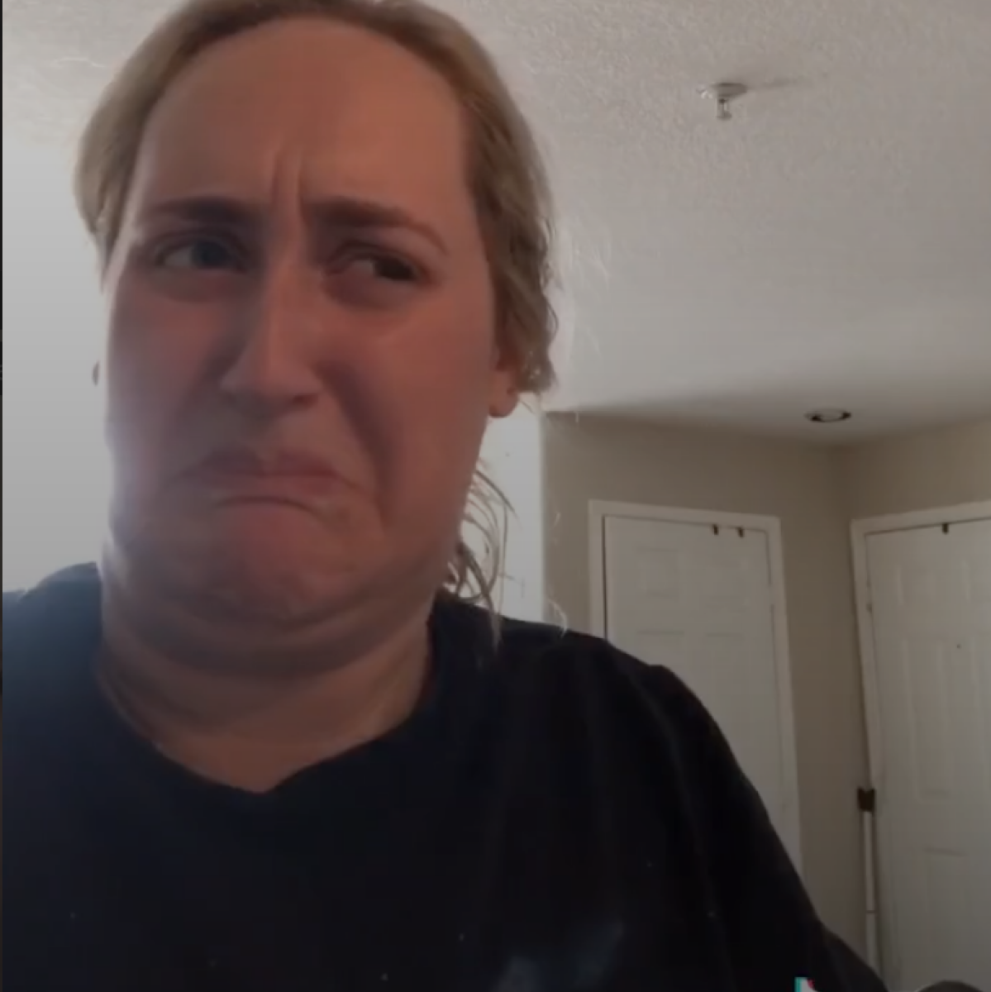
It was ugly

Slide 8
preprocessing

Slide 9
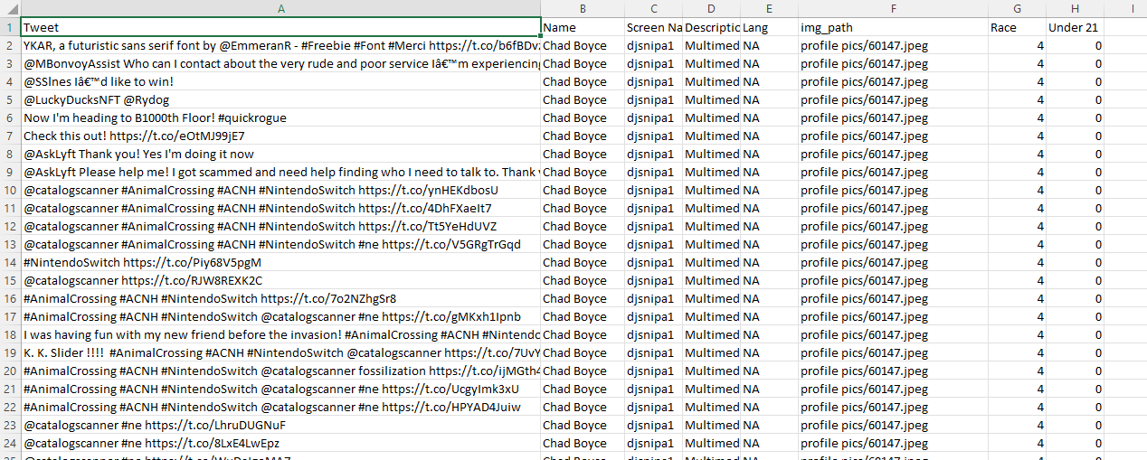
How it looks like

Slide 10
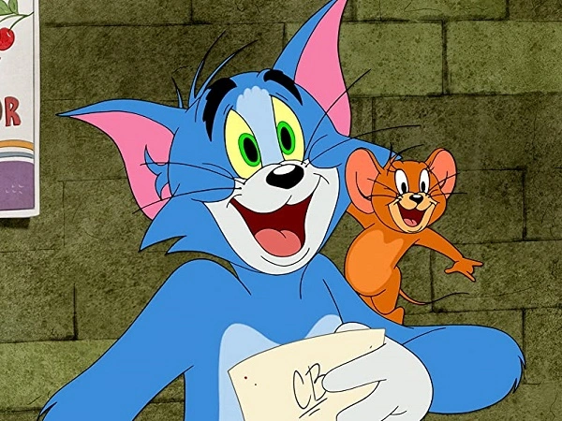
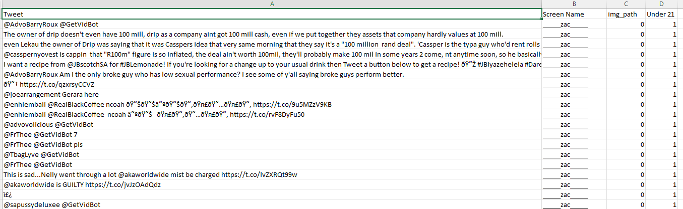
Smart and Sexy

Slide 11
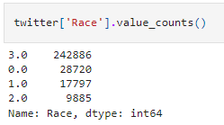

Unbalanced Labels distributions
-> Cause overfitting

Slide 12
Building Race Prediction Models

Slide 13
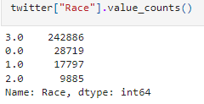
Race Prediction Model with Tweets
Imbalanced labels

Slide 14
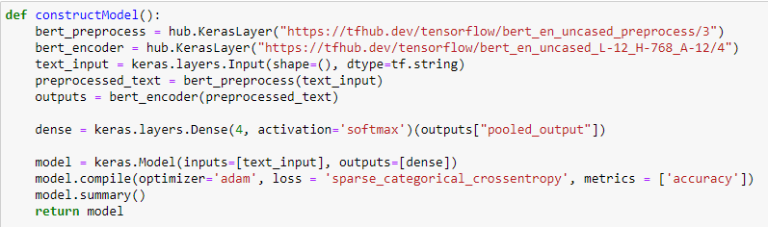
First Attempt
BERT models for text classification combine with Tensorflow Keras Neural Network

Slide 15
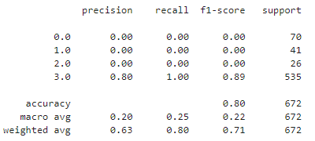
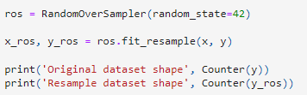
Failure
Our BERT model achieved 82% accuracy, but suffered from poor recall
Tried using oversampling the minority classes to correct:

Slide 16
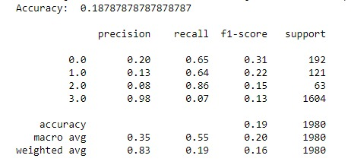
Result
Not so great. Oversampling did not work!

Slide 17
Alternate solution
TF-IDF
5000 unigram features
Logistic Regression with multi-class predictions
Balanced class weights
Notes:
TF stands for term frequency, not tensorflow in this case

Slide 18
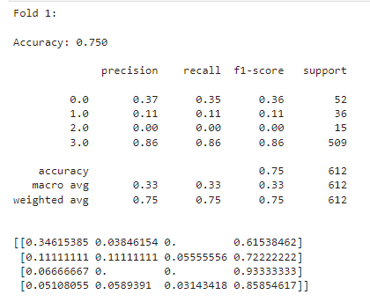
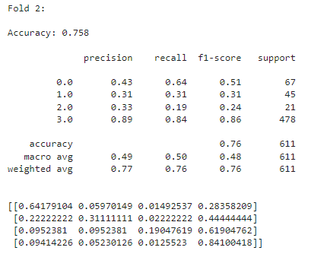
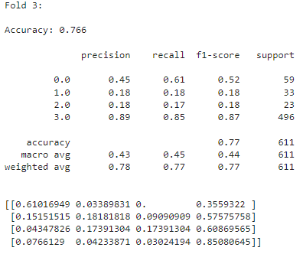
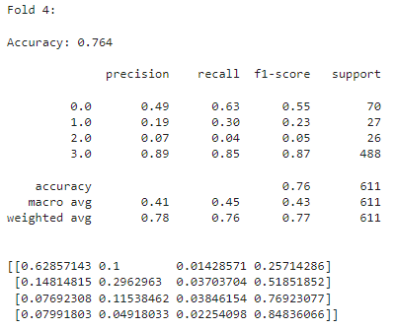
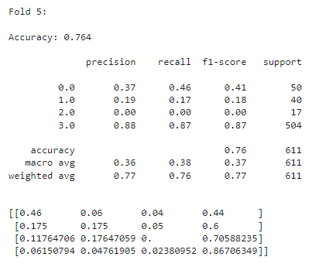
K-Fold Validation for Race Models
5 Folds

Slide 19
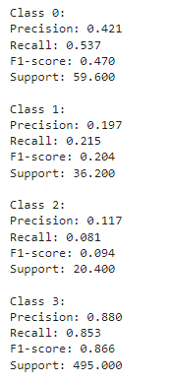


Result
Confusion matrix
-> 76% accuracy

Slide 20
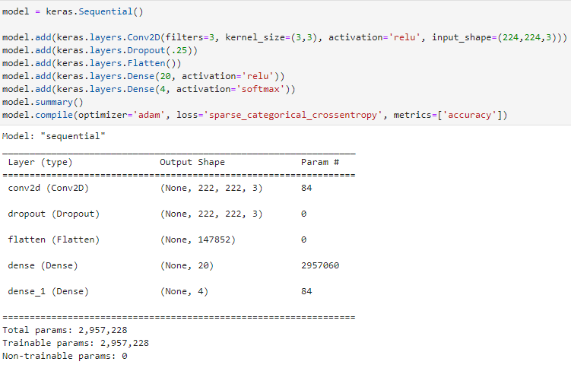
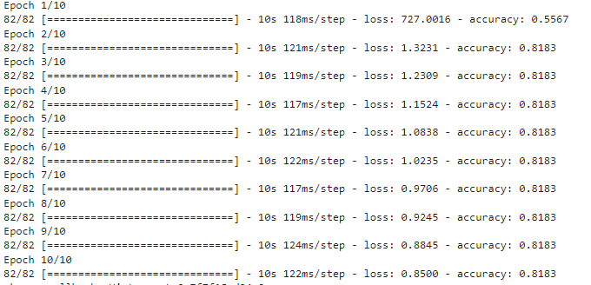
Race Prediction Model with profile pictures
Keras Neural Networks from Tensorflow

Slide 21
Same problem as before
Unbalanced data leads to high accuracy and poor recall
Decided profile pictures were not useful for this project

Slide 22
Preprocessing Age Prediction Dataset

Slide 23
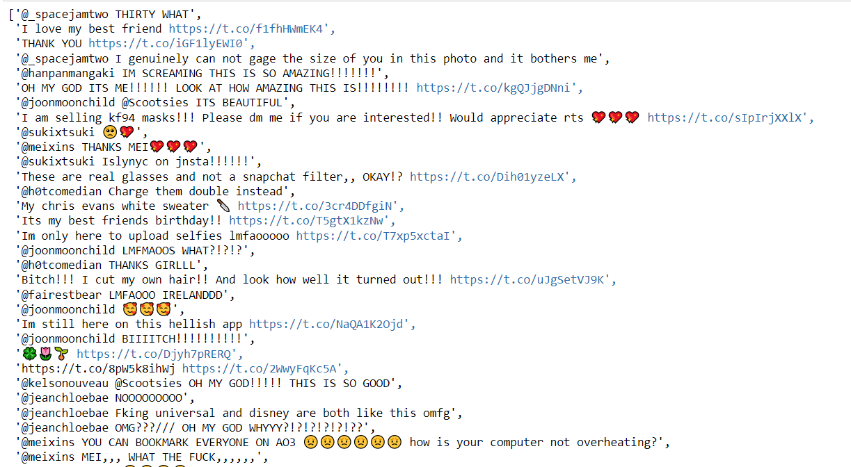
tweets.json
2678 users, 100 tweets per users

Slide 24
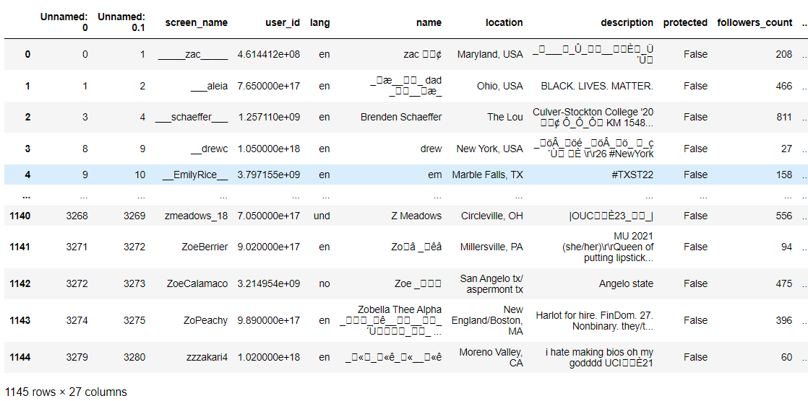

labeled_users.csv
1145 users
Division of labels: -

Slide 25
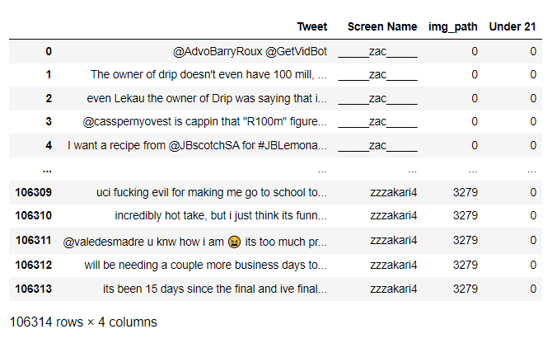

Combining, and extracting columns
1145 screen names
Approx 100 tweets per screen name
Division of labels: -

Slide 26
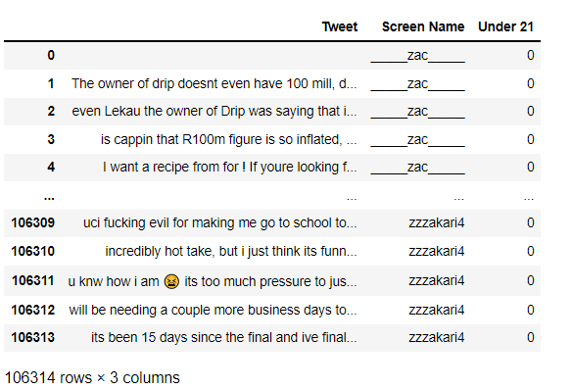
Cleaning Tweets
Removed HTML Tags, @Username, #Hashtags, https links, and punctuations.

Slide 27
Age Prediction Models
Naive Bayes Classifier
Logistic Regression
BERT Model Classification
BERT Model Classification after Oversampling

Slide 28
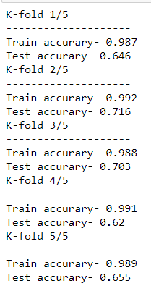
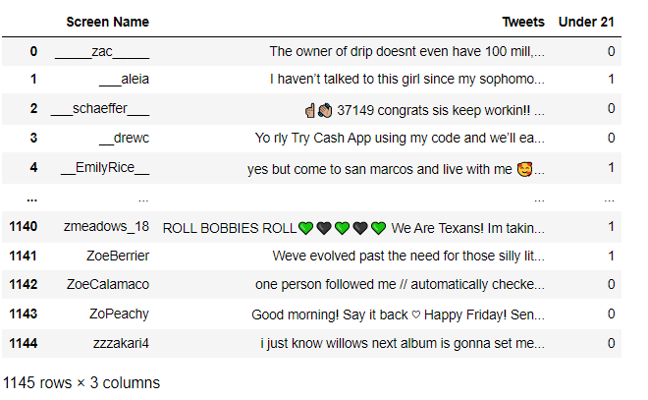
Naive Bayes Classifier - Age Prediction
Create Dataframe of Concatenated Tweets for every user.
Create dictionary of tokens using CountVectorizer() while removing stop words.
Used MultinomialNB() as model.
Perform 5-cross validation on the dataset.

Slide 29
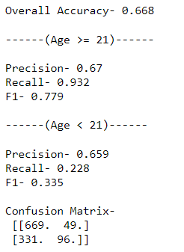
Results for Naive Bayes Classifier - Age Prediction
66.8 % Accuracy
Poor recall w.r.t Label 1

Slide 30
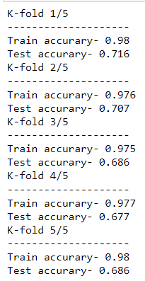
Logistic Regression - Age Prediction
Same Dataframe of Concatenated Tweets for every user.
Feature extraction using TfidfVectorizer() while removing stop words.
Used LogisticRegression() as model.
Perform 5-cross validation on the dataset.

Slide 31
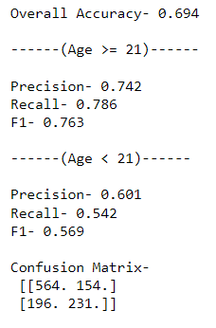
Results for Logistic Regression - Age Prediction
Accuracy of 69.4%
Better Recall w.r.t Label 1

Slide 32
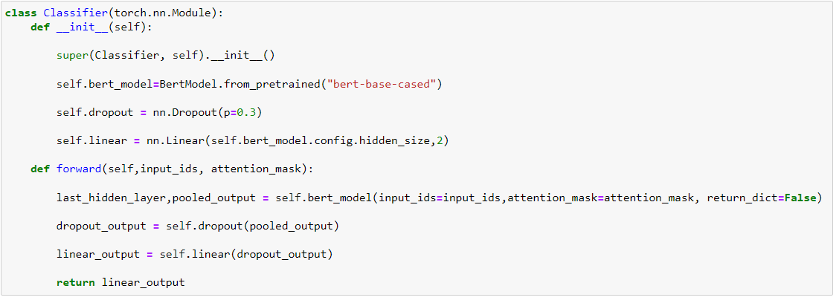
BERT Model Classification - Age Prediction
Pytorch Neural Network Model

Slide 33
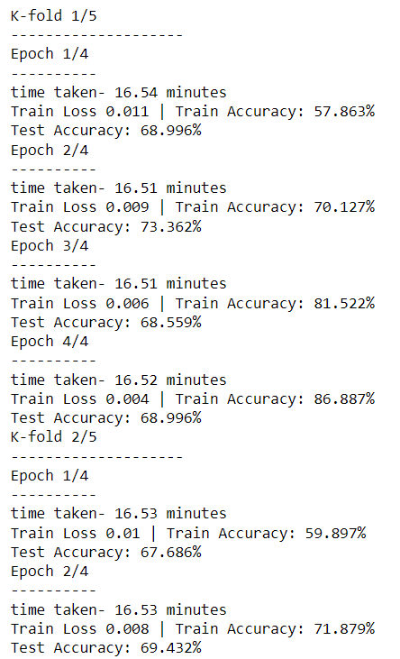
BERT Model Classification - Age Prediction
Training and Testing
5-fold cross validation split by screen names. [No Concatenation]
Used BertTokenizer for converting tweets into tokens for BERT Model. Added padding to same length. (Max Len - 160)
Train model with all tweets in train split regardless of screen names.
4 Epochs per Fold and Batch Size = 64.
For each user, test model with all tweets, take most frequent prediction and use it as prediction for the user.

Slide 34





Oversampling
Distribution of Users
Distribution of tweets during training of BERT Model, before and after oversampling.

Slide 35
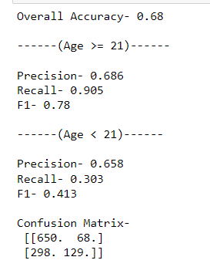
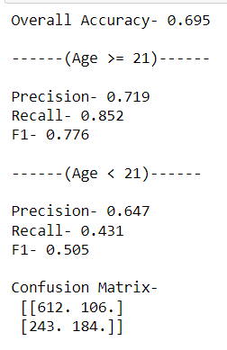
Results for BERT Model Classification - Age Prediction
Without Oversampling
With Oversampling
68% Accuracy
Low recall w.r.t label 1 due to imbalance in labels
1.5 % increase in Accuracy.
Slight increase in recall.

